Slide 1

Web Development
Sister Nivedita University - Kolkata
Mentored By – Roop Kumar Chatterjee
Led By – Anik Dutta

Slide 2
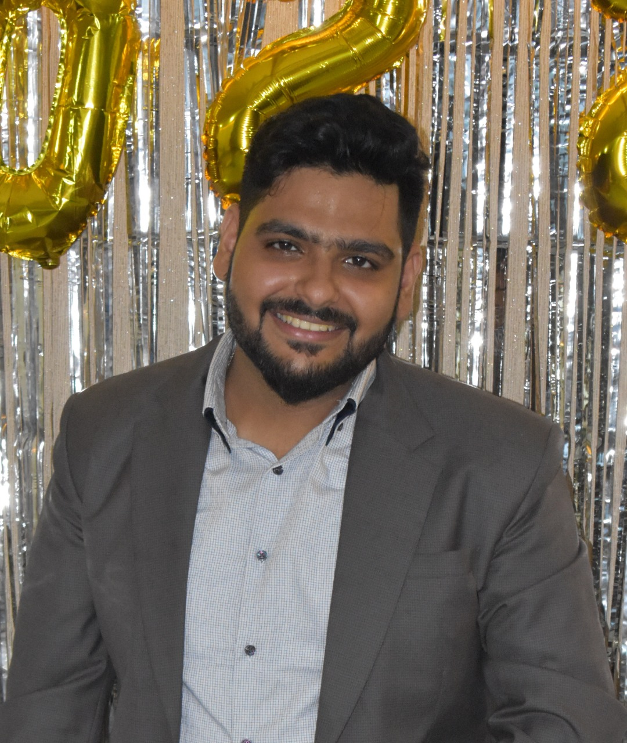
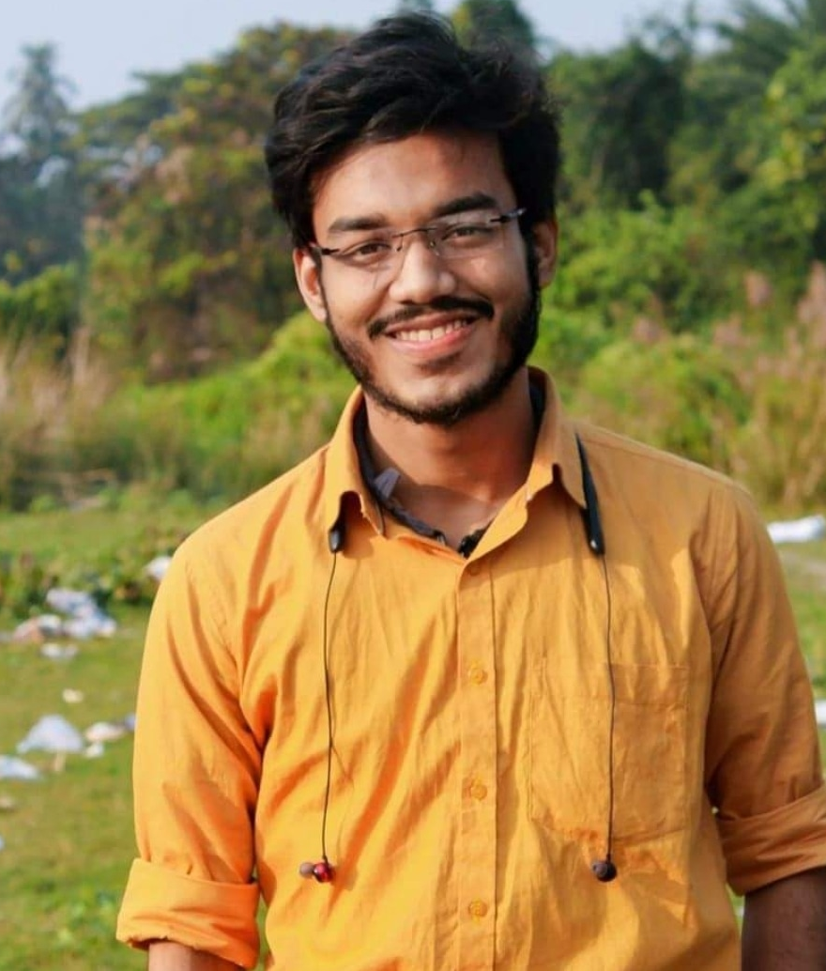
Meet The Mentor & Lead
Mentor – Roop Kumar Chatterjee
Lead – Anik Dutta

Slide 3
Why should you learn web development ?
there will be approximately 1.4 million jobs available in LinkedIn and indeed.
You won’t have to worry about finding jobs for web developers any time soon.
There is a huge demand of react developer .

Slide 4
WHAT CAN YOU LEARN FROM THIS CLUB?
How to Build a basic web application ?
A clear knowledge of frontend and backend development .
How to build a Responsive website ?
You will gain a great experience of web dev for your resume .

Slide 5

HTML5, CSS3, JAVA SCRIPT .
NODE JS for Backend Development .
REACT JS for Frontend Development . Web hosting to Remote Server .
Our Roadmap

Slide 6
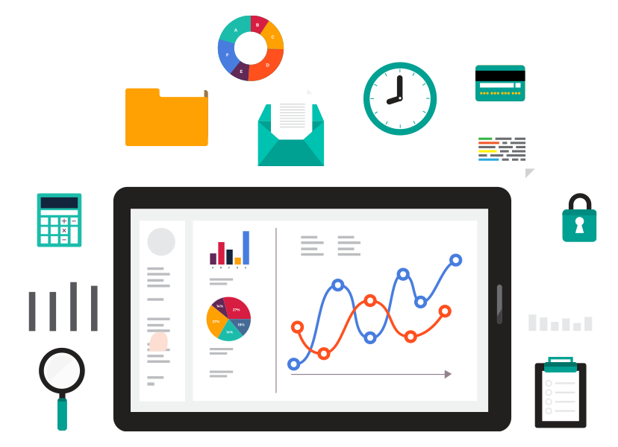
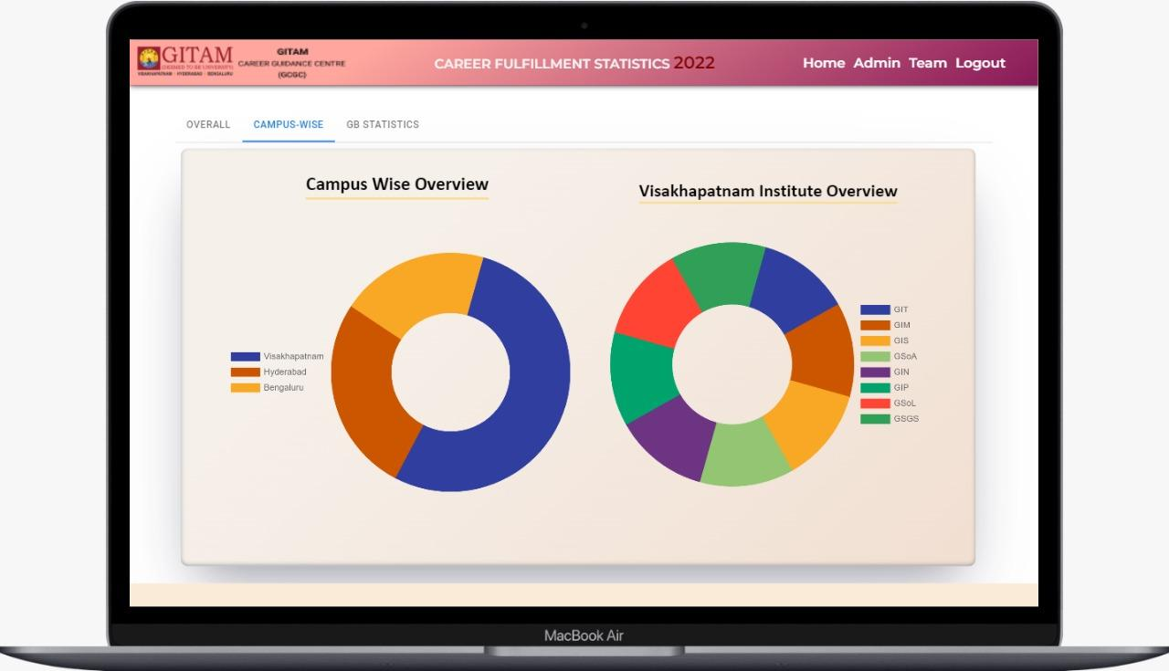
PROJECTS
We will complete 3 to 4 mini projects, these will improve your skills and knowledge .
After the entire session we will complete a capstone project .

Slide 7
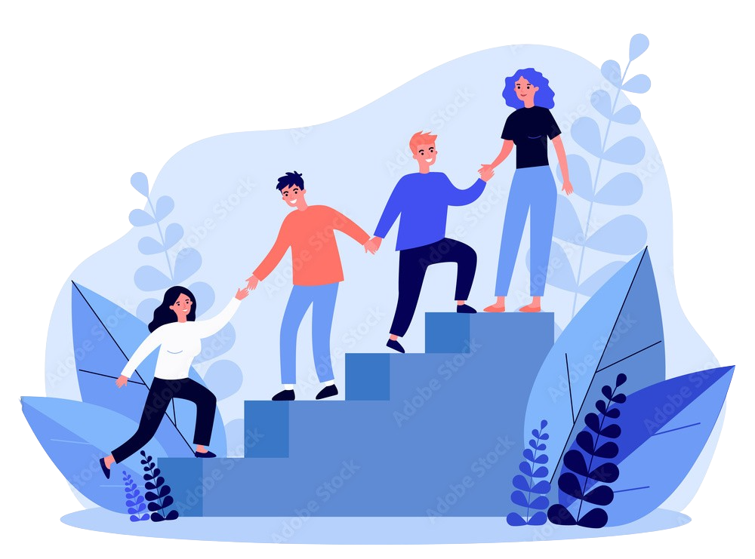
Our Goal -
We will learn web development from beginning to ending .
We engage students in workshops, tech sessions and hands on projects .

Slide 8
THANK YOU

